Slide 1
Convolutional Neural Networks
BY UMANG KEJRIWAL

Slide 2
Convolutional Neural Networks
Image Processing is a method to perform some operations on an image, in order to get an enhanced image or to extract some useful information from it. It is a type of signal processing in which input is an image and output may be image or characteristics/features associated with that image.
Computer Vision is a field of computer science that works on enabling computers to see, identify and process images in the same way that human vision does, and then provide appropriate output. It is like imparting human intelligence and instincts to a computer. In reality though, it is a difficult task to enable computers to recognize images of different objects.
© UMANG KEJRIWAL

Slide 3
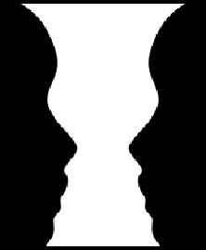
Convolutional Neural Networks
© UMANG KEJRIWAL

Slide 4
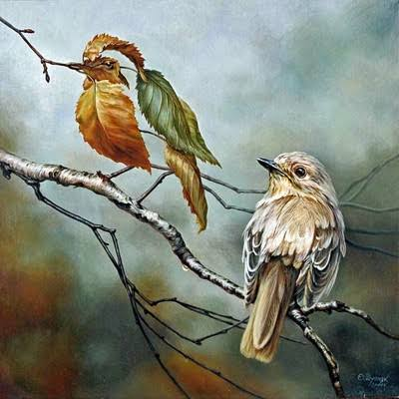
Convolutional Neural Networks
© UMANG KEJRIWAL

Slide 5

Convolutional Neural Networks
But, the question arise, how will be learning in this stage?
Let’s understand the learning first about kids!
© UMANG KEJRIWAL

Slide 6
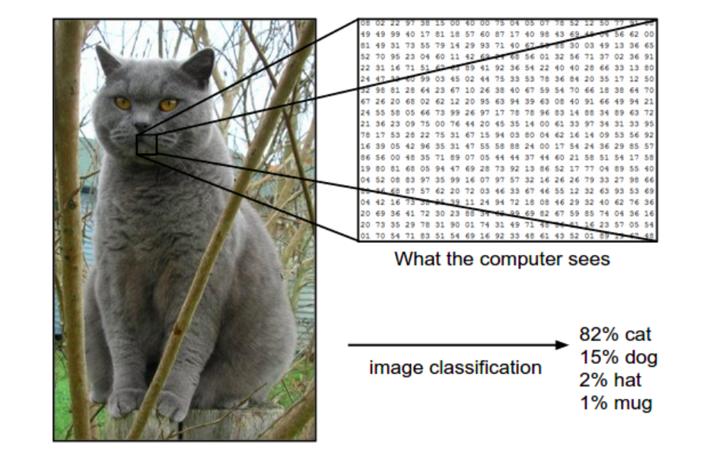
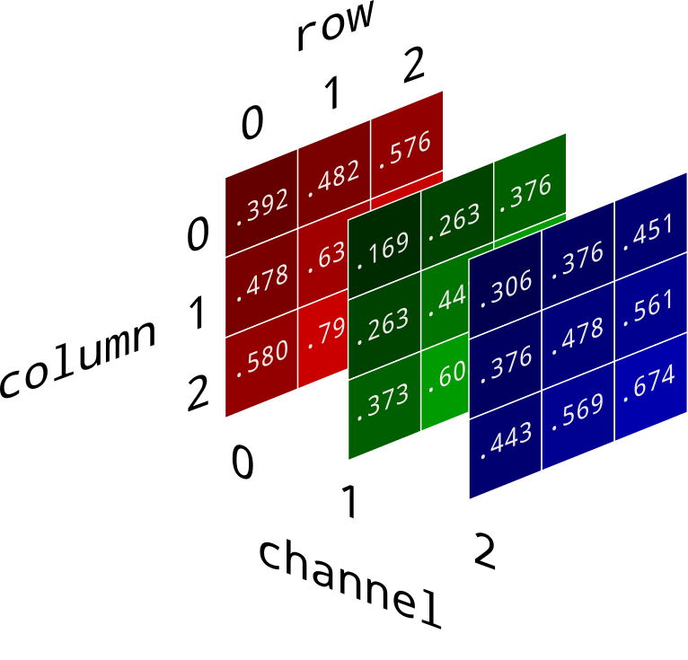
So, what about the Computer? CNN?
Learning… (by image features)
Gray scale image or RGB image
© UMANG KEJRIWAL

Slide 7
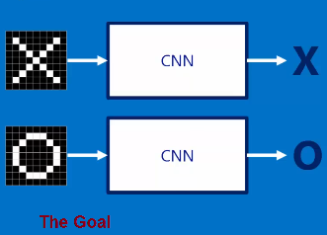
So, What about the Computer? CNN?
Learning…
X
O
Here CNN work as like black box, so what is inside the black box!
© UMANG KEJRIWAL

Slide 8
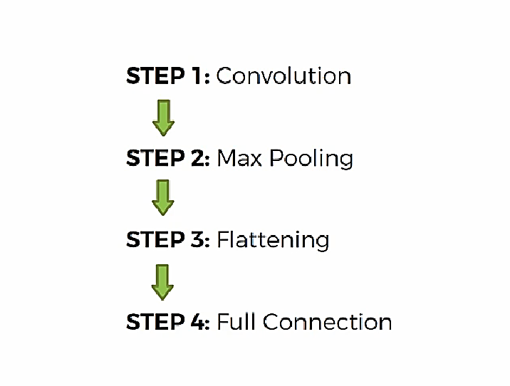
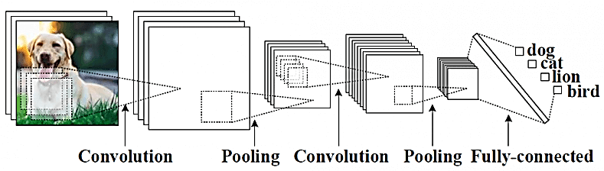
Steps in CNN
© UMANG KEJRIWAL

Slide 9
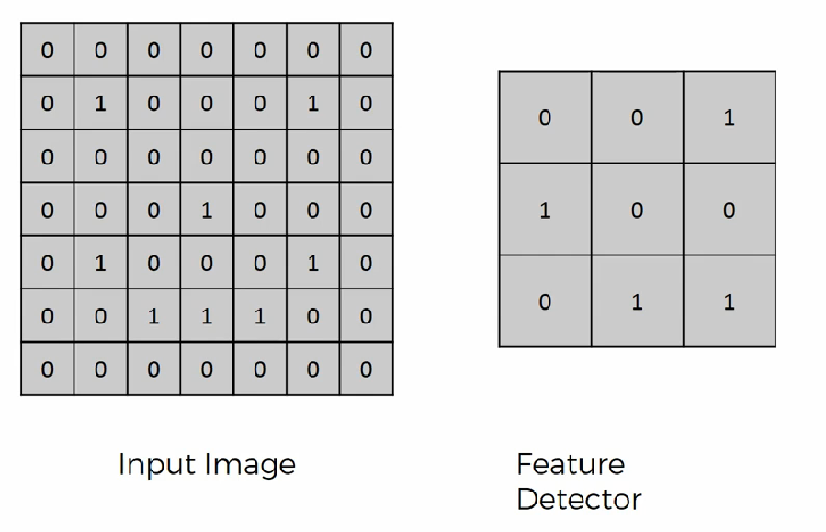
1. Convolutional ( of Smiling Face)

Slide 10
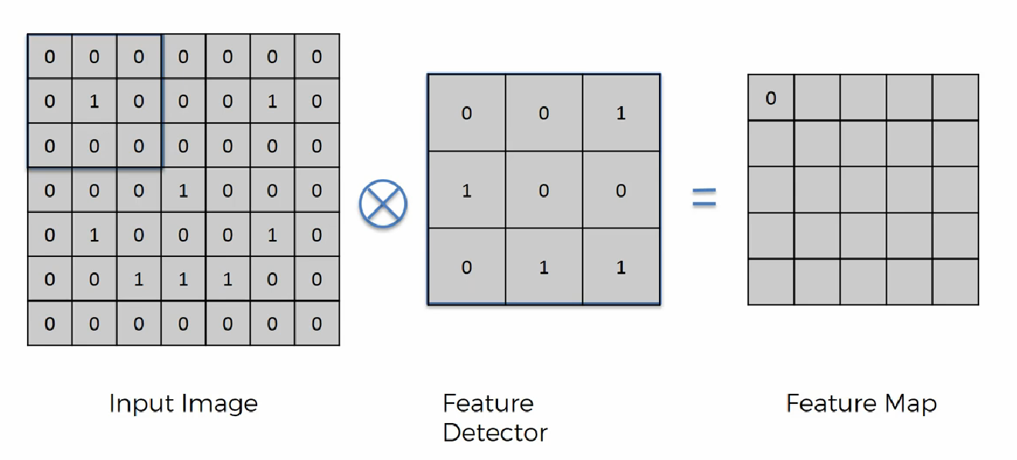
1. Convolutional ( of Smiling Face)

Slide 11
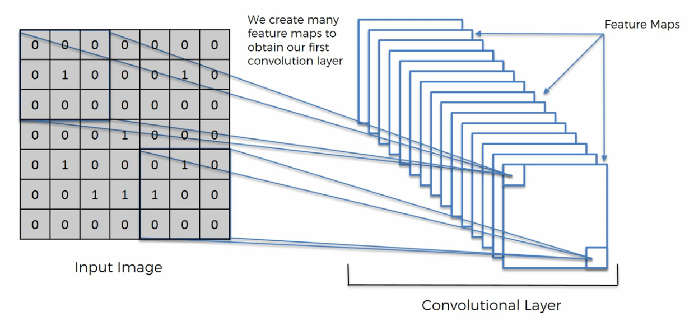
1. Convolutional ( of Smiling Face)

Slide 12
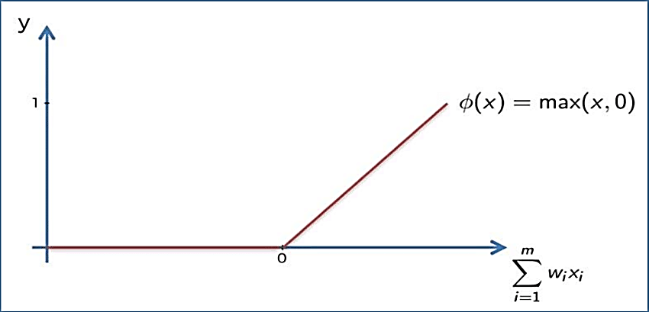
1. Convolutional ( of Smiling Face)
Appling ReLu Activation function to decrease the linearity in the image, because the image originally non linear!

Slide 13
1. Convolutional ( of Smiling Face)
Different kind of filters / kernels in image processing!
http://setosa.io/ev/image-kernels/

Slide 14
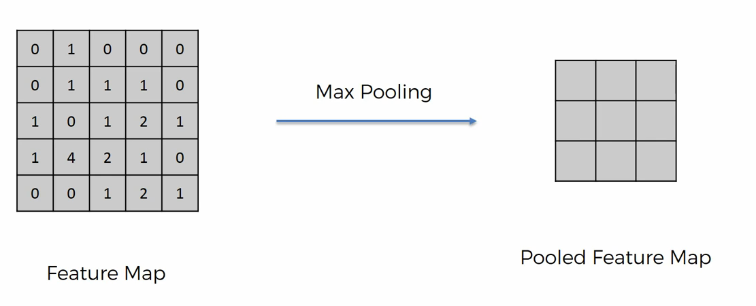
2. Pooling
A pooling layer is another building block of a CNN. Its function is to progressively reduce the spatial size of the representation to reduce the amount of parameters and computation in the network. Pooling layer operates on each feature map independently. The most common approach used in pooling is max pooling.

Slide 15
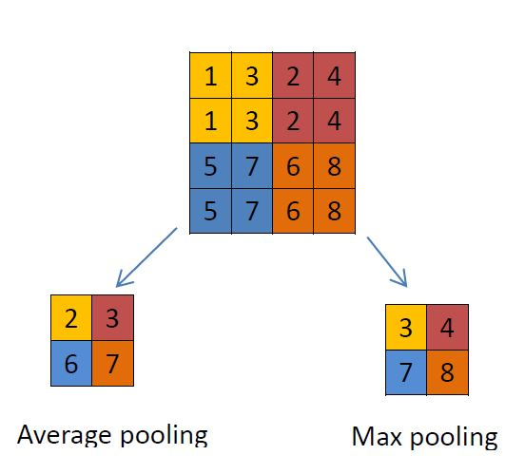
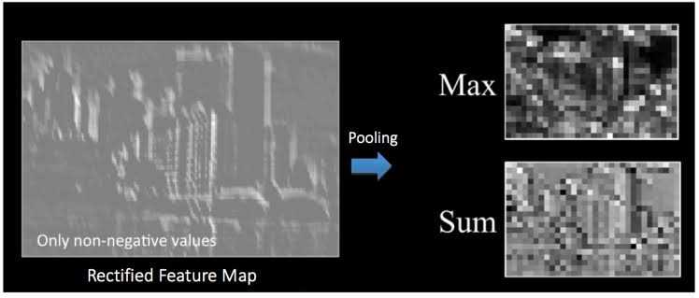
Max / Avg. Pooling

Slide 16
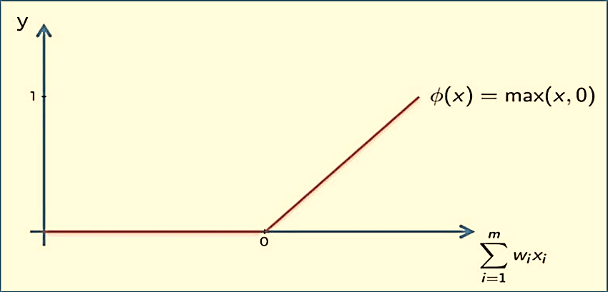
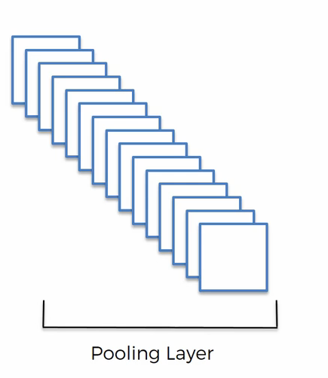
Pooling…

Slide 17
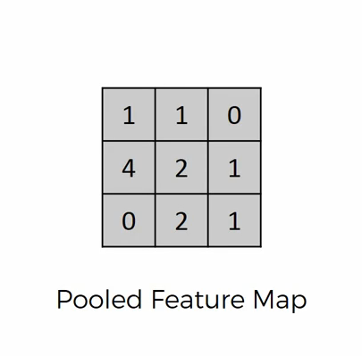
3. Flattening
Flattening is converting the data into a 1-dimensional array for inputting it to the next layer. We flatten the output of the convolutional layers to create a single long feature vector. And it is connected to the final classification model, which is called a fully-connected layer

Slide 18
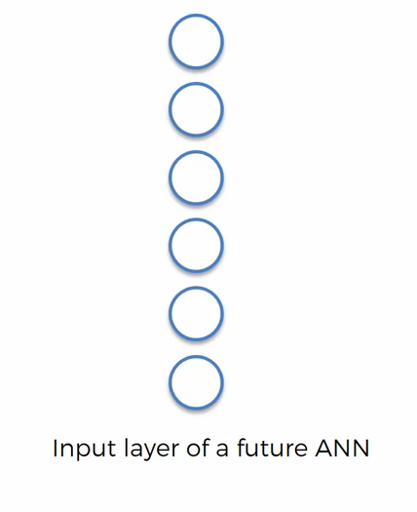
Flattening …

Slide 19
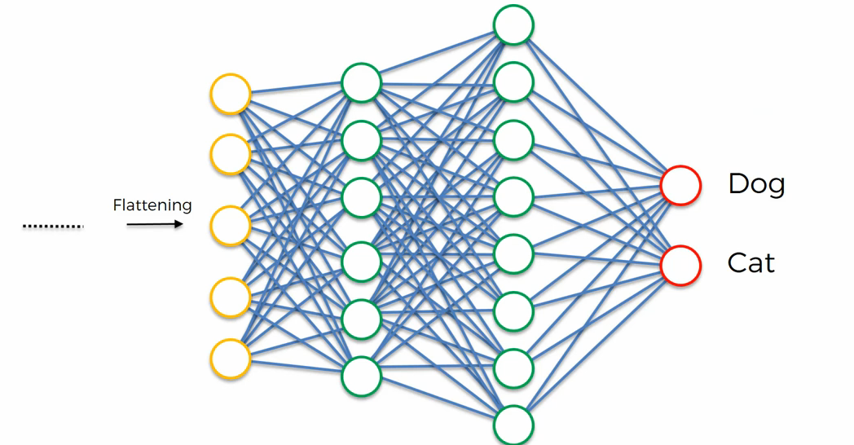
4. Fulling Connection

Slide 20
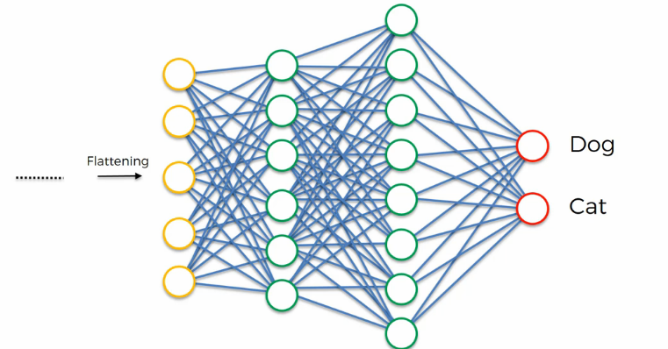
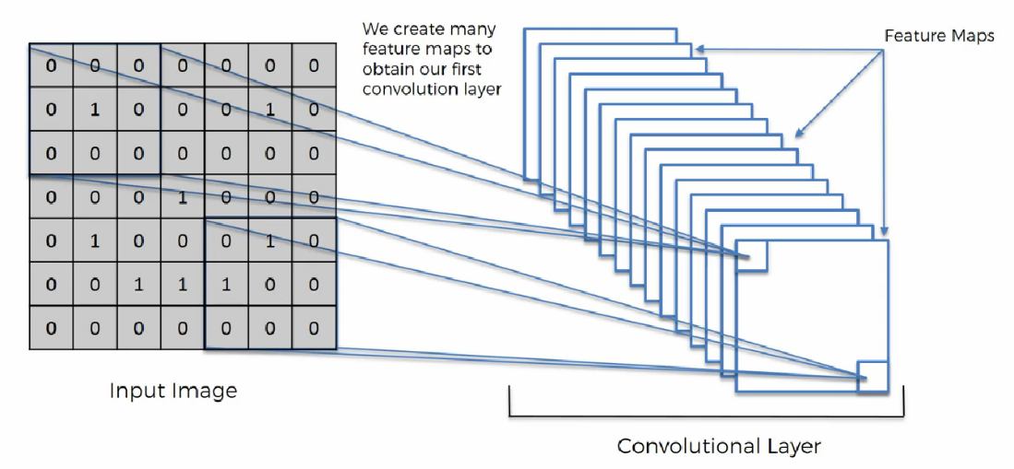
Complete CNN in one View

